Slide 1
SDI MDE Subgroup
First Milestone meeting

Slide 2
Features of the app and use case
Two types of users: End users and admins
End users query the database to discover datasets of interest based on metadata requirements (specify timeframe, data quality, license etc.)
Admins can introduce new datasets into the database along with optional preexisting metadata
Our application can automatically discover metadata from a dataset
Preexisting metadata can be verified against the output of our extractor
The metadata is stored in our database (do not store datasets)

Slide 3
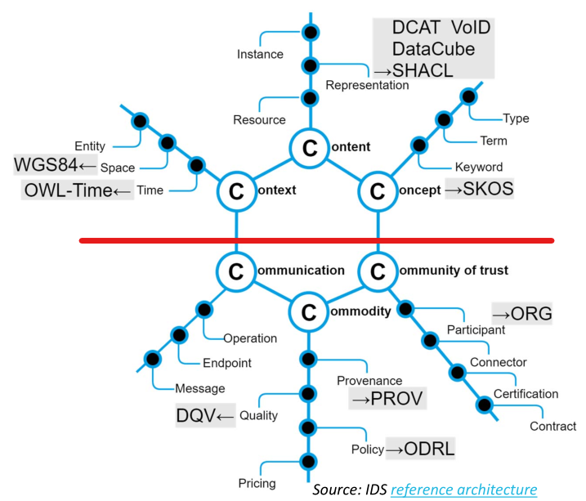
A remark on the IDS IM
As a Resource’s content is its most essential as-
pect, Content is located at the top of the hexagon. This con-
tent is interpretable by references to a shared, formally de-
fined Concept, whereas links to a particular Context (in terms
of time, place, or real-world entities) make the content poten-
tially relevant for certain Data Consumer. So the upper part of
the C-Hexagon deals with the “what” aspects, independently
of Data Exchange, Data Sharing or Data Utilization. The low-
er part relates to the “how” aspects; i.e. how the content is
exchanged (Communication) and under which conditions
(Commodity).
[IDS RAM 3.0 2019 p. 43]

Slide 4
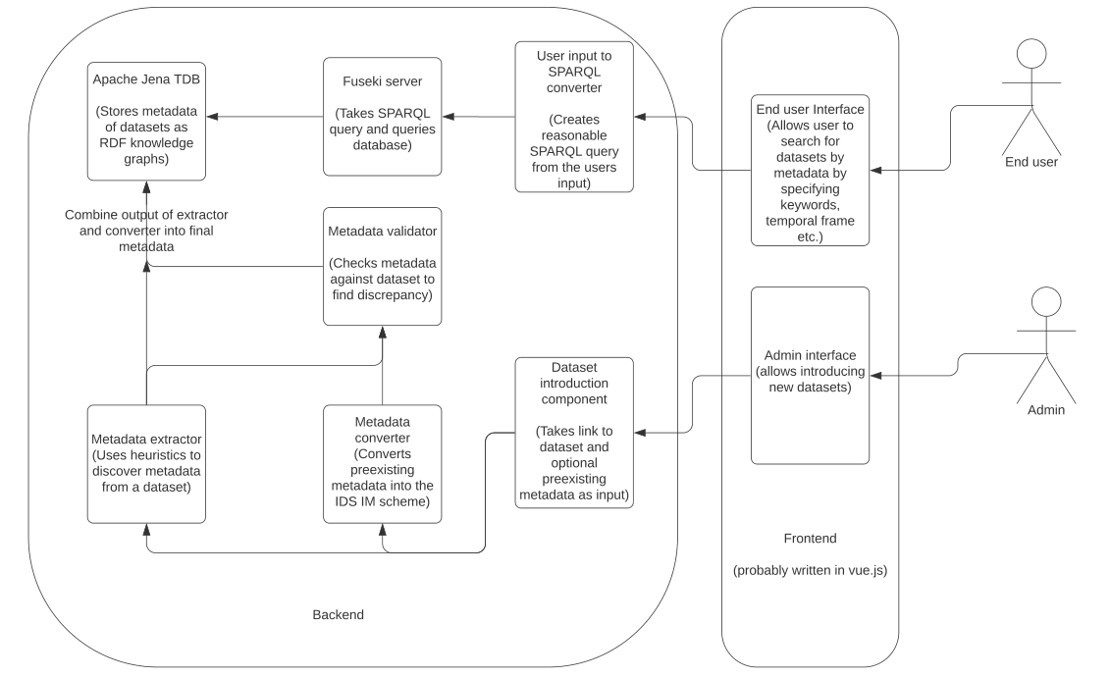
Architecture Diagram

Slide 5
More on the extractor
Uses heuristics to discover pieces of metadata from a “naked” dataset
Can use general data science techniques (libraries: java tablesaw; spark dataframe for scalability)
Off the shelf software available (e.g. Deequ for data quality etc.)
At first, restrict to CSV data; expand later
E.g.: Keyword discovery, temporal context, data quality, language…

Slide 6
More on the converter
Takes preexisting metadata and reexpresses this using the IDS IM
Which formats to support?

Slide 7
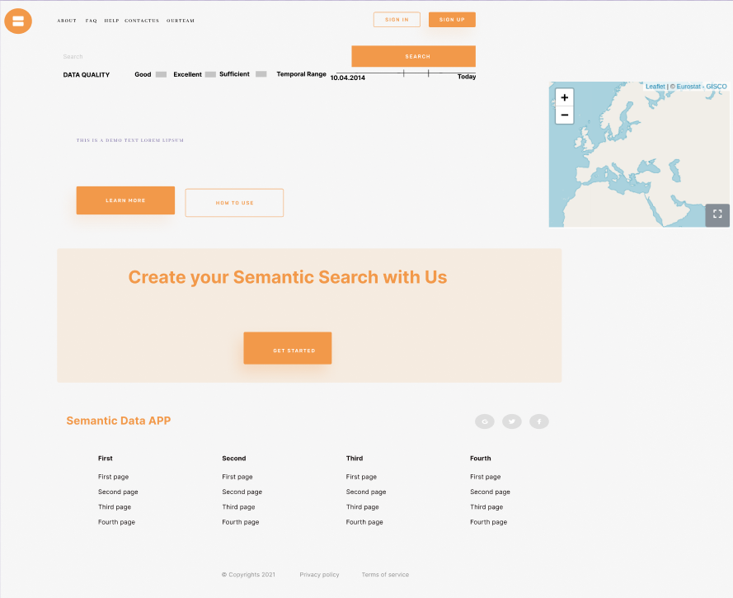
More on the UI

Slide 8
Workplan
Meet every Friday (to discuss progress)
Next week: Get Jena and Fuseki set up; start conceptual work on the extractor components (e.g. how to do X); set up CI/CD on Gitlab
In two weeks: Have end user prototype (allows queries) and prototype of extractor components
In three weeks: Testing, Integration, Bugfixes
In four weeks: prototype of the entire system

Slide 9
Questions
How to model metadata quality issues (i.e. how to specify that a piece of metadata disagrees with the dataset it describes)
Which metadata to keep: our extracted metadata or the provided one?

